Slide 1
COMP 7745 : Machine Learning Instructor: Salim Sazzed Department of Computer Science University of Memphis

Slide 2
Instructor: Salim Sazzed (Visiting Assistant Professor)
– Office: TBA – Phone: 757-275-5573
– Email: ssazzed@memphis.edu
- TA: Hong Shi (hshi@memphis.edu) and Venkat Narsimha Reddy Velga (vvelga@memphis.edu)
- TA Office hours: please email
Research interests: machine learning, bioinformatics, computer vision, and natural language processing.

Slide 3
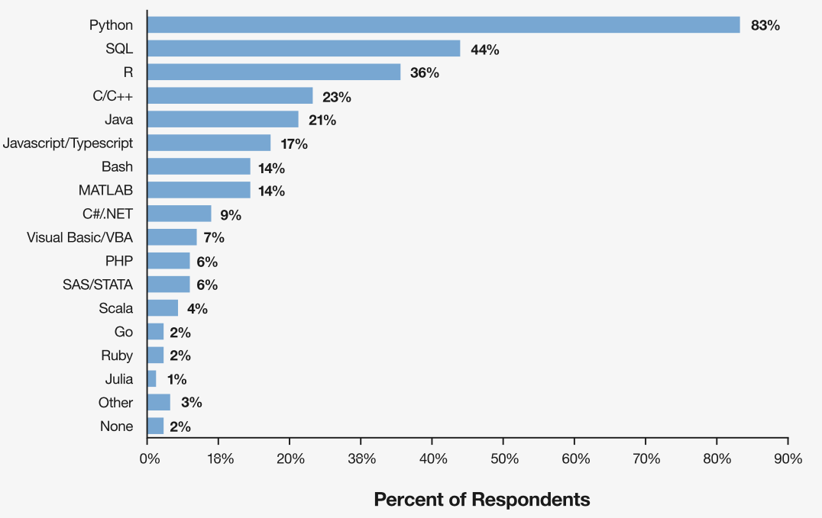
Background requirements
Basic Linear Algebra
Vector and Matrix
Dot Products
Eigenvector and eigenvalue
Statistics
Probability
Mean, Variance, etc.
Programming background with python
Note: Data are from the 2018 Kaggle Machine Learning and Data Science Survey. A total of 18,827 respondents answered the question. (source: https://c3.ai/)

Slide 4
Objectives:
– Master basic concepts of machine learning, such as data representation, different kinds of learning problems, modalities, transformation, overfitting/underfitting, bias, noise, incomplete data, etc.
– ML Algorithms: Understand the foundations of some commonly-used machine learning methods and algorithms
– Get informed of the state of the art (SOTA) algorithms in the field
– Get familiar enough with some machine learning methods in solving practical problems
Format :
– Lecture slides, YouTube videos, Online blogs.
Grading: homework assignments, paper reviews, several exams and final exams, and a term project.

Slide 6
Grading Policy (subject to change):
Assignments (2-3): 10%
Monthly Exams (3): 30% ( best to worst: 15% (1st) , 10% (2nd), 5% (3rd)).
Final Exams (1): 20%
Paper Presentation (1): 10%
Project (1): 30%
Bonus credit: 10%

Slide 8
Topics to be covered
Introduction of machine learning problems, basic concepts, review of basics of probability, basics of linear algebra.
Supervised learning
– Regression (linear regression, overfitting, ridge regression, LASSO, gradient descent, stochastic gradient descent)
– Classification (logistic regression , decision tree, support vector machine
, k-nearest neighbor, ensemble learning, etc.)
– Model evaluation (F1 score, ROC curve, etc.)
Unsupervised learning – Cluster analysis (k-means, hierarchical clustering, DBSCAN, etc.) – Dimension Reduction (PCA, CCA, etc.)
Neural networks and Deep learning
– Shallow multilayer perceptron and back propagation algorithm
– Deep learning (Convolution Neural Network (CNN))

Slide 11
https://www.youtube.com/watch?v=HcqpanDadyQ

Slide 12
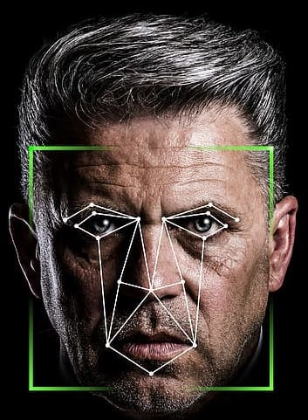
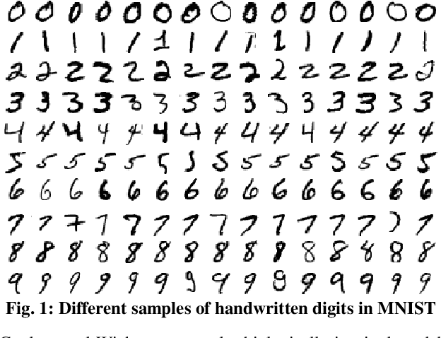
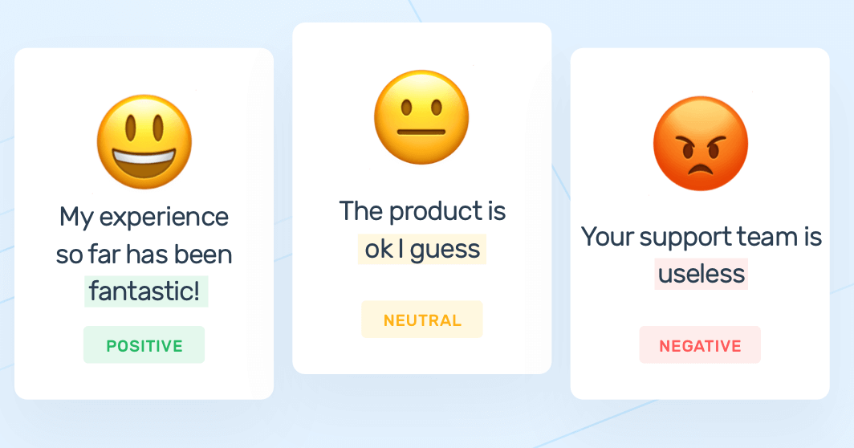
ML Systems
Handwritten Digit Recognition
Sentiment Classification
Facial Recognition

Slide 16
Rule-based system Vs Learning-based System
Rule-Based Systems:
Operates based on a set of predefined rules.
Rules are explicitly programmed to describe how the system should make decisions or take actions in various situations.
Rule-based systems rely on a knowledge base of if-then rules, where the "if" part represents the conditions or inputs, and the "then" part represents the actions or outputs.
Follow the rules in a deterministic manner and don't involve learning from data.
Machine Learning:
Teach a computer to learn concepts using data or interactions with an environment– without being explicitly programmed
It focuses on the development of computer programs that can adapt when exposed to new data
https://www.youtube.com/watch?v=_N2iIB_bLXA

Slide 17
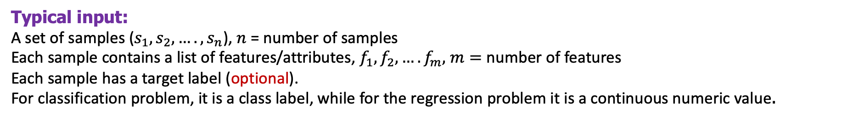
Machine Learning
Typical input:
A set of samples ($s_{1},s_{2},…., s_{n}$), $n$ = number of samples
Each sample contains a list of features/attributes, $f_{1},f_{2},….f_{m},$ $m=$ number of features
Each sample has a target label (optional).
For classification problem, it is a class label, while for the regression problem it is a continuous numeric value.
Features
Target
(class label)
Sepal Length | Sepal Width | Petal Length | Petal Width | Species
5.1 | 3.5 | 1.4 | 0.2 | Iris-setosa
4.9 | 3.0 | 1.4 | 0.2 | Iris-setosa
7.0 | 3.2 | 4.7 | 1.4 | Iris-versicolor
6.4 | 3.2 | 4.5 | 1.5 | Iris-versicolor
6.3 | 3.3 | 6.0 | 2.5 | Iris-virginica
5.8 | 2.7 | 5.1 | 1.9 | Iris-virginica
Sample Dataset: Iris Flower Classification:
The goal is to classify iris flowers into three species based on four features: sepal length, sepal width, petal length, and petal width.
Samples
Notes:
This dataset is a classic example in machine learning and is often used for demonstrating classification algorithms.

Slide 18
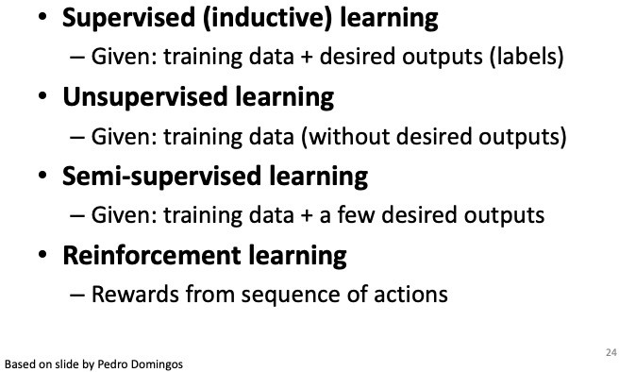
Types of Learning
https://www.youtube.com/watch?v=ukzFI9rgwfU

Slide 19
Supervised Learning
Learns how to map input data to corresponding output labels based on a set of samples (n samples), each having m features.
S₁ <f₁, f₂,….., f_{m>} , S₂ <f₁, f₂,….., f_{m}>, …, S_{n} <f₁, f₂,….., f_{m}>
Supervised refers to the fact that the training process involves a teacher or supervisor who provides the algorithm with labeled examples to learn from.
These labeled examples consist of input data and their corresponding correct output labels.
Training set: samples with labels used in training process in machine learning model
Testing set: new/unseen data , model predicts the target/class label of samples

Slide 20

Supervised Machine learning
Testing
Training
New Data
Data
Output
Program
Output
Example by Dr. Kilian Weinberger

Slide 21
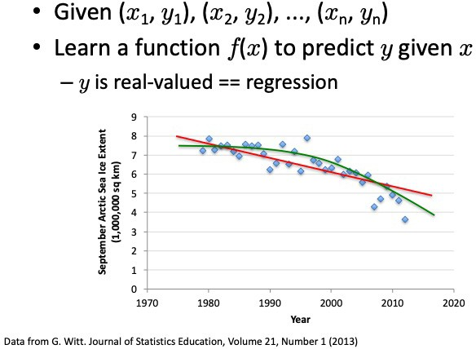
Supervised Learning: Regression
Regression models the relationship between a dependent variable and one or more independent variables.
To understand how changes in the independent variables are associated with changes in the dependent variable.
Regression helps us predict or estimate the value of the dependent variable based on the values of the independent variables.

Slide 22
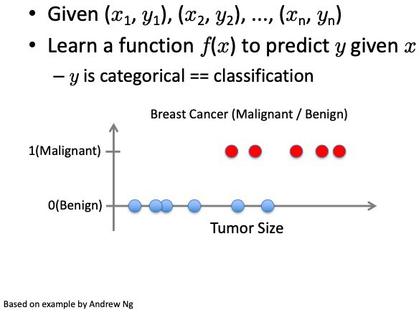
Supervised Learning: Classification

Slide 23
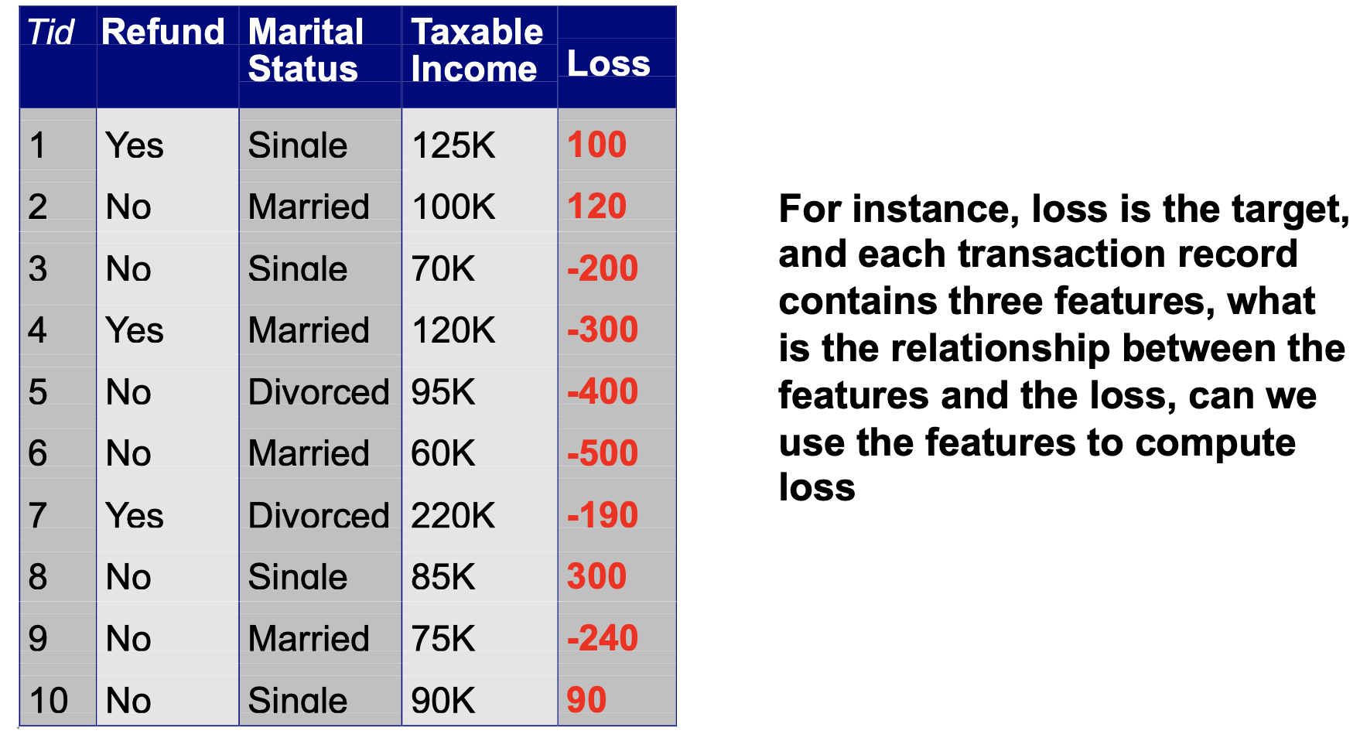
Supervised Machine Learning (Another example)
Given a collection of examples (training set)
Each example contains a set of features (independent variables), and a supervision label that serves the target or dependent variable.
Supervised learning goal: find a model or a mapping that
best maps from the features to the target.

Slide 24
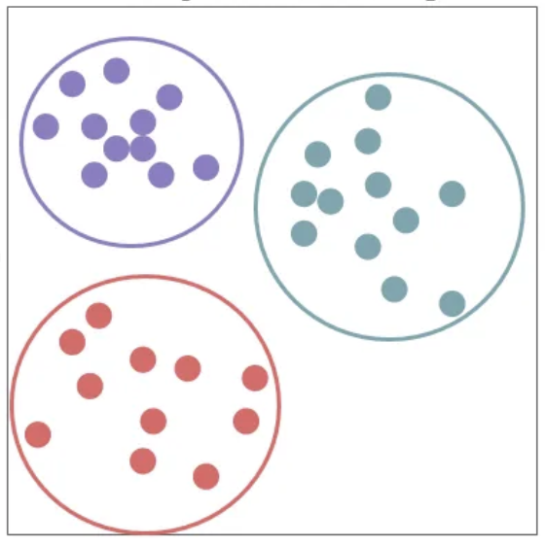
Unsupervised Learning

Slide 25
Unsupervised Learning

Slide 26
In-class practice
Given data about the size of houses on the real estate market, try to predict their price
● For a collection of 10,000 patients, find a way to automatically group them into subgroups that are similar by different variables, such as lifespan, location, race, etc
● Given a picture of a face, predict which person’s face it is
● Given a patient with a tumor, predict whether the tumor is
malignant or benign
● Given a recoding of sound recorded from a party, try to identify if the sound comes from one source, or different sources, and try to segment the different sources

Slide 27
Self-Supervised Learning
Data annotation is costly process (time-consuming and expensive).
Usually, a lot more unlabeled data available than labeled
Can we utilize some unlabeled data in learning process ?
Benefit : Cost reduction and lot more data
Limitation: Quality and diversity of the unlabeled data (e.g., Propagation of Errors)

Slide 28
Semi-supervised Learning
Assume a set L of labeled data and U of unlabeled data (from the same distribution)
Self-Training (a simple algorithm)
Train a supervised model on labeled data L
apply on unlabeled data U
Add the most confidently classified members of U to L
Repeat
Slide modified from Stanford CS329, Fall-2021

Slide 29
Another approach
Utilize rule-based system when only unlabeled data U available
Generate pseudo-labels based on applying some domain-specific rules (high confidences predictions) on U
Train a supervised model utilizing pseudo-labeled (PL) data
Apply on other unlabeled data and add them to training set
Train the model again and apply on a new set of unseen data

Slide 30
Recap:
Machine Learning:
Learning from data -> Performs Prediction/Estimation/Grouping
Supervised Machine Learning:
Learn mapping between input data and corresponding label (target). Perform prediction/estimation.
Unsupervised Machine Learning: No Target label. Find patterns in input data to group them
Self-supervised learning: Try to create additional labeled data from labeled/unlabeled data

Slide 31
Useful Videos:
https://www.youtube.com/watch?v=nKW8Ndu7Mjw
https://www.youtube.com/watch?v=KzH1ovd4Ots&list=PLoROMvodv4rNH7qL6-efu_q2_bPuy0adh

